Slide 1



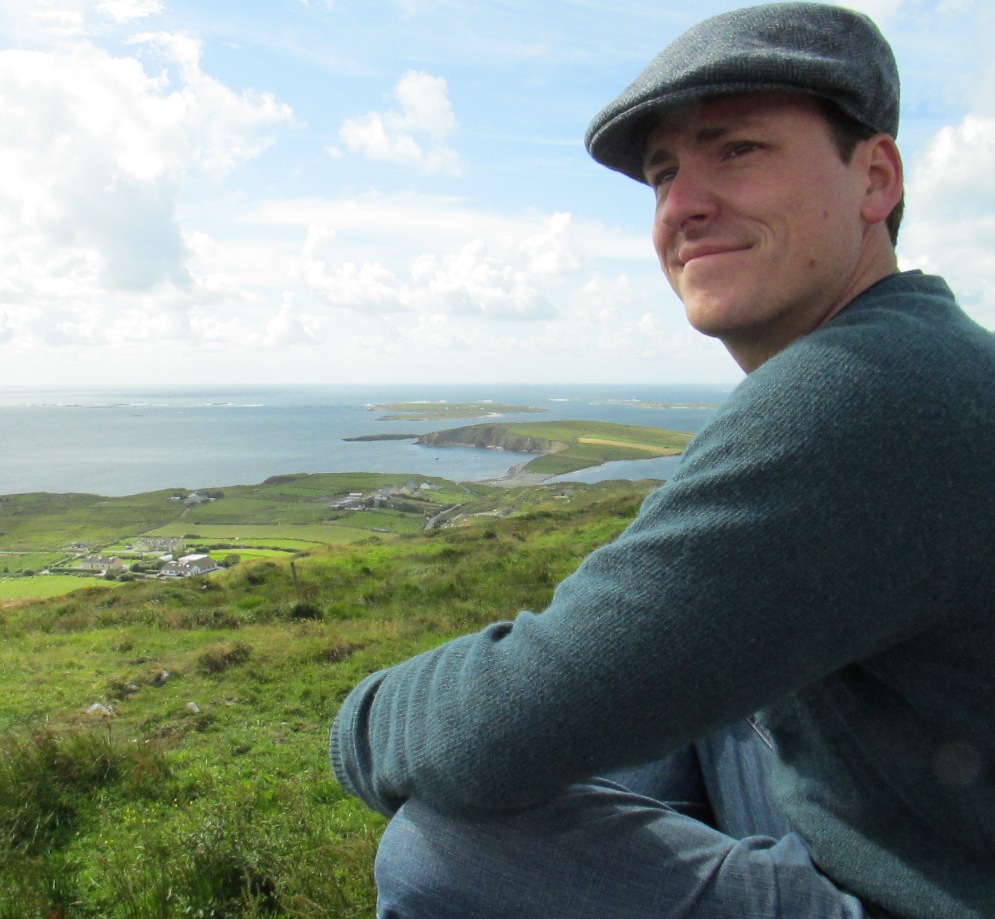
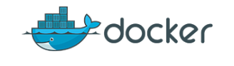

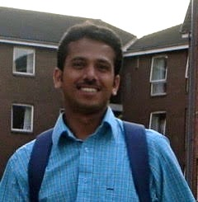
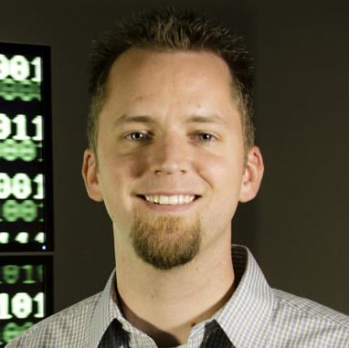

Journey to the Compute
Day 1: Containers to Quiet the Dependency Hells
By Blake Joyce
Blatantly copied, smashed together, melted down, and reforged from efforts by:
Upendra Devisetty
John Fonner
Tyson Swetnam

Slide 2
What We Are Really Interested In
Larger compute resources
Accomplish tasks not feasible on local
Accomplish tasks faster
Always be lazy! Laziness is directly responsible for civilization (more on this later)
Data-driven decision making expedited
Cheaper (free!?) resources
Single time use of specialty resources (GPUs, etc)
Off hour consumption is really cheap
Basically this translates as: HPC or Cloud

Slide 3
Setting Expectations of This Workshop
We’re focusing on intro abilities
CyVerse
Medium scale compute
Democratization of analyses (GUIs)
Walk in the door registration
Development environment
TACC and XSEDE
Big compute
Command line interfaces
XSEDE requires allocations

Slide 4

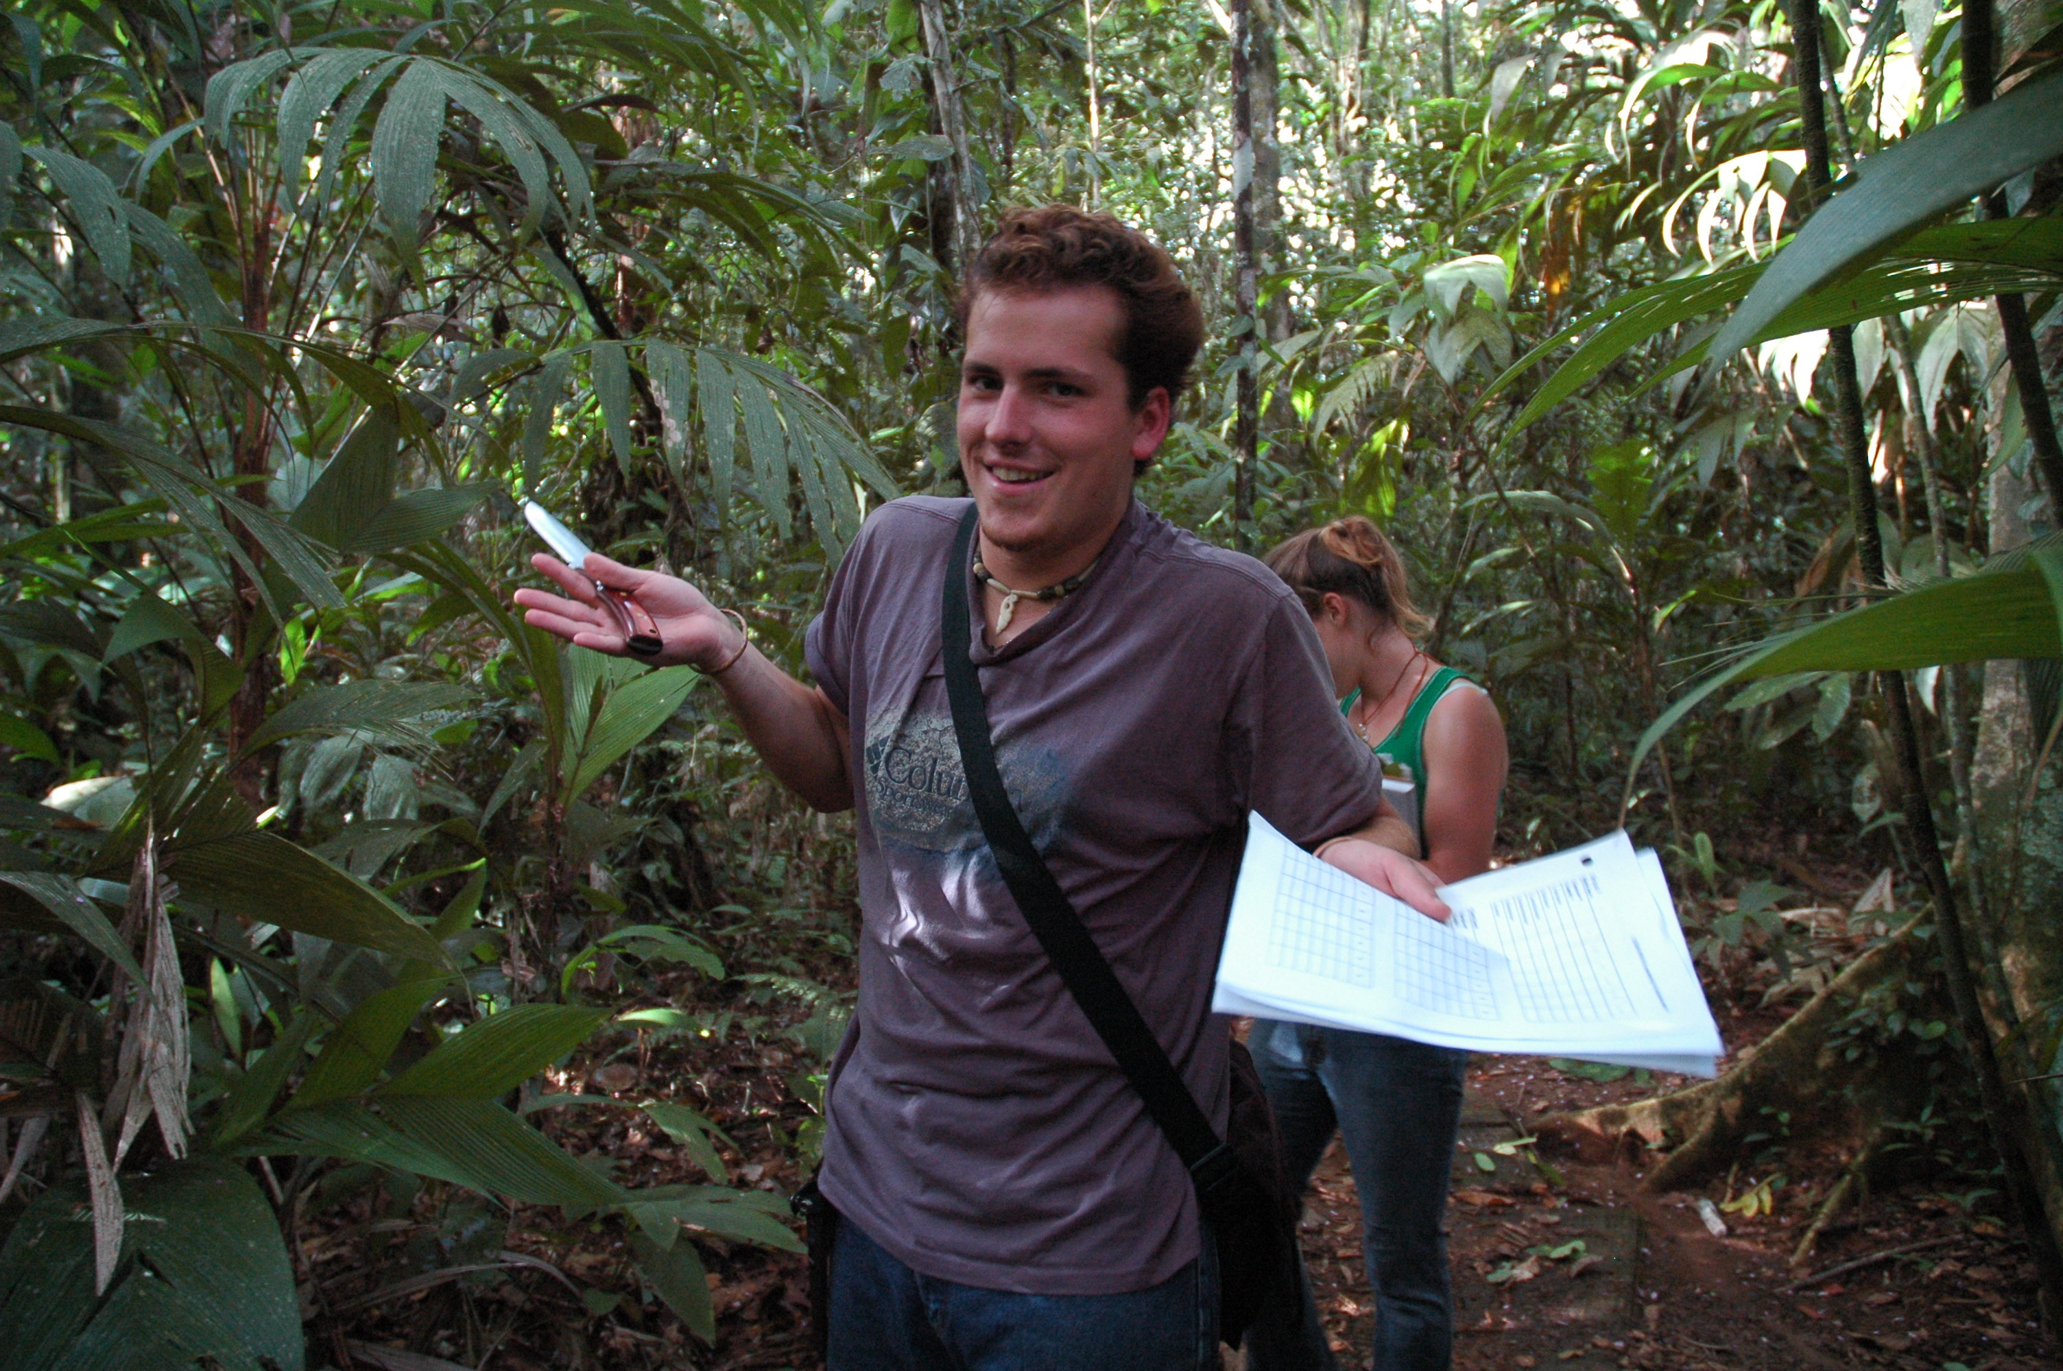
Setting Your Expectations of Me
I am a life scientist
Postdoc at CoGe
(dubbed ‘the code curious biologist’)
PhD in Plants, Soils, and Insects
Master’s in Plant Molecular Biology
Bachelor’s in Ecology; another in Biology
I am fairly irreverent and prefer humor
Though I can be serious (Figure 1)
Mostly I’m not (Figure 2)
I’m told it’s a Gambit-like charm
I am pragmatic to a fault
These lessons will be overly simple
If you have questions ask at any time
If you have personally specific questions: save them for happy hour

Slide 5

Speaking of Happy Hour…
There’s also
Shut Up & Write
Fridays
8:00-10:00
UA iSpace
Science & Engineering Library

Slide 6
Here’s the Tools We Need
Docker
Containerized software and dependencies
Runs a Docker daemon and requires root access
Simplistically: containers = light virtual machines
Singularity
Not just ‘Docker for HPC’
Doesn’t allow root access
Circumvents the ‘request to install’ on HPCs

Slide 7
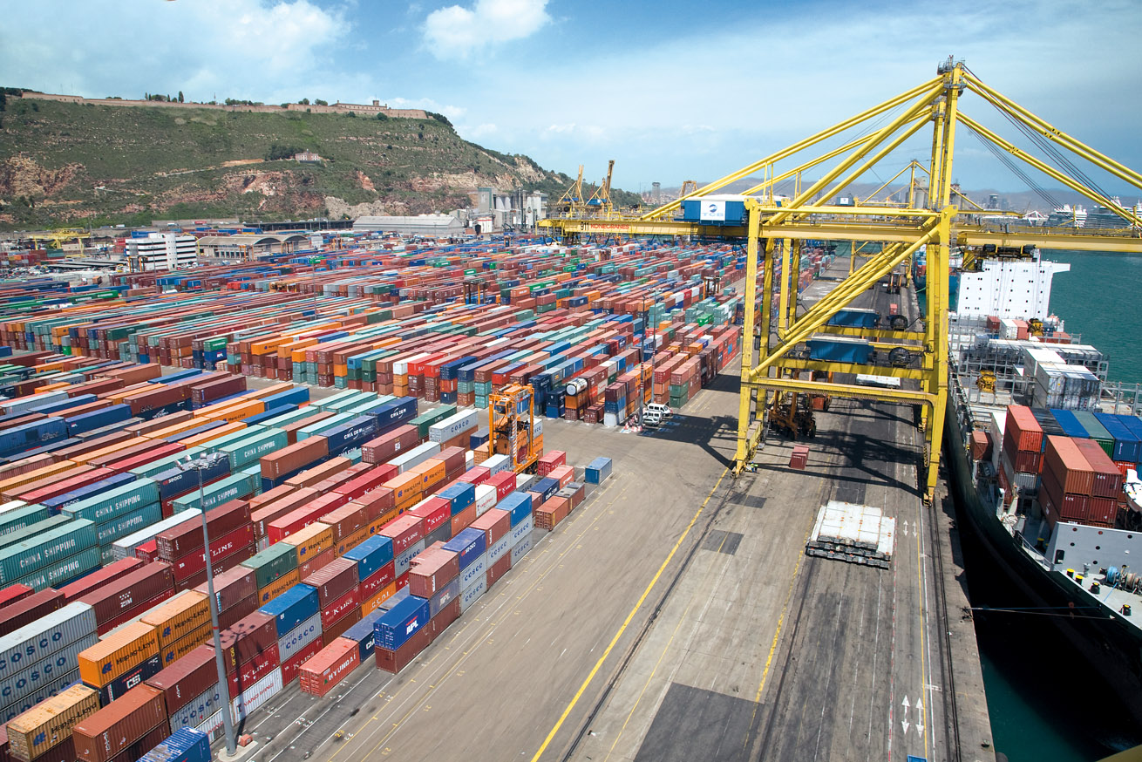
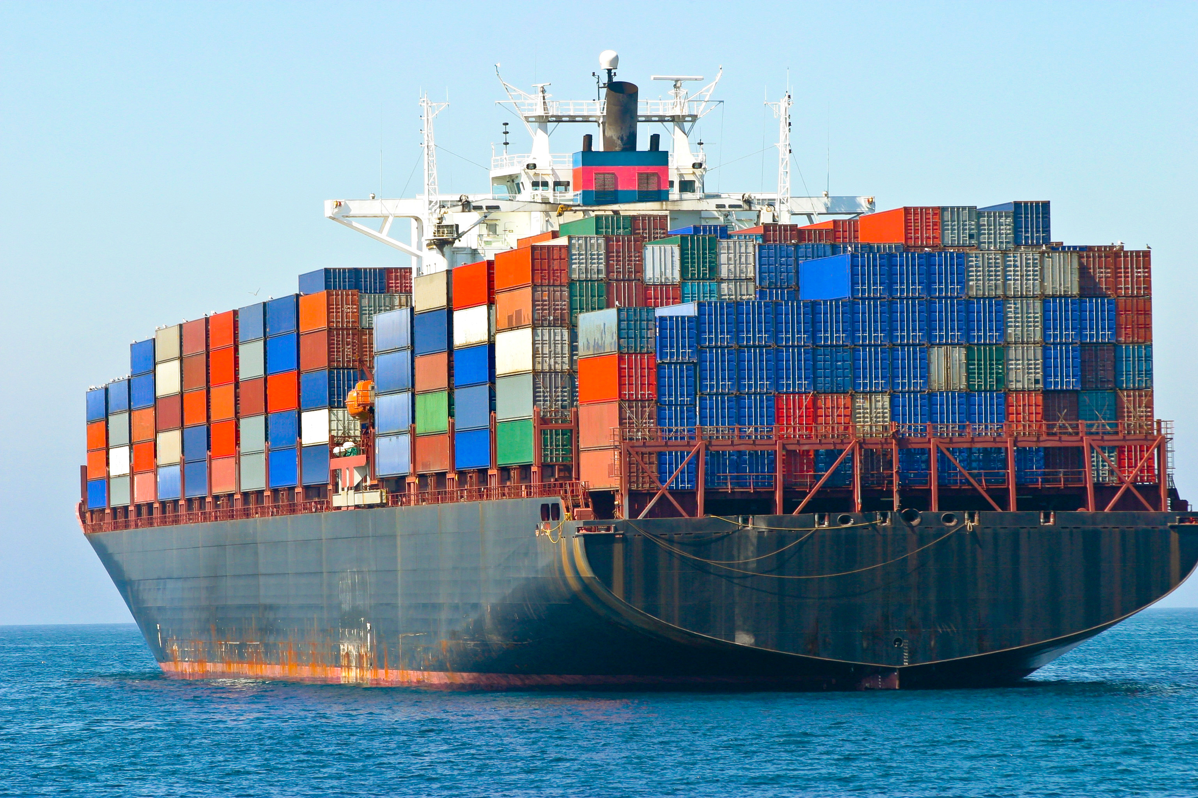
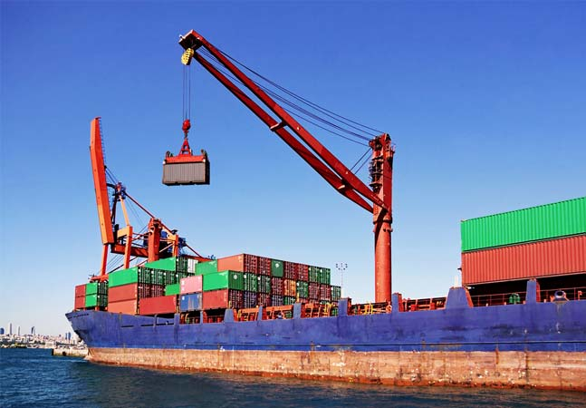
Uh Wait, What’s All This About Containers
Fill the Container
“DockerHub”
Science! Or Analysis! Or Whatever!
Setting up Compute (VM or HPC node)
Notes:
Supplier -> Consumer
Shipping containers are a standard height and width
Everyone has agreed to that standard!
One unit of impossible social engineering

Slide 8
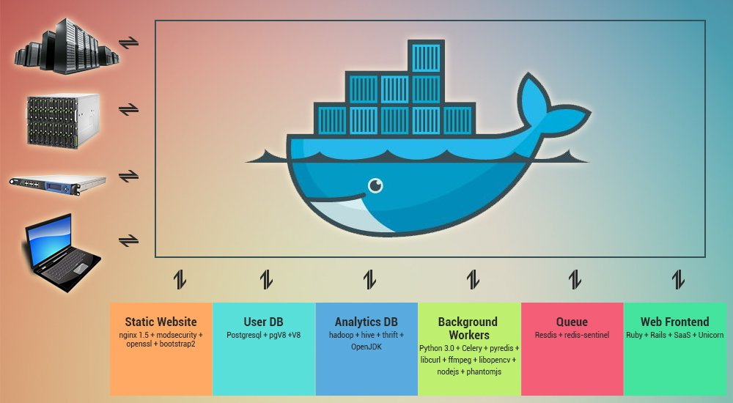
Uh Wait, So Who Cares?
From: https://www.openxcell.com/containerize-your-startup-with-docker

Slide 9
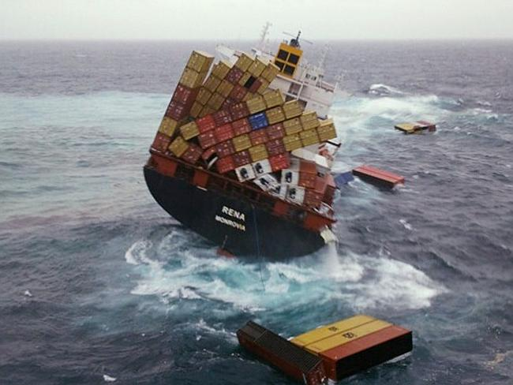
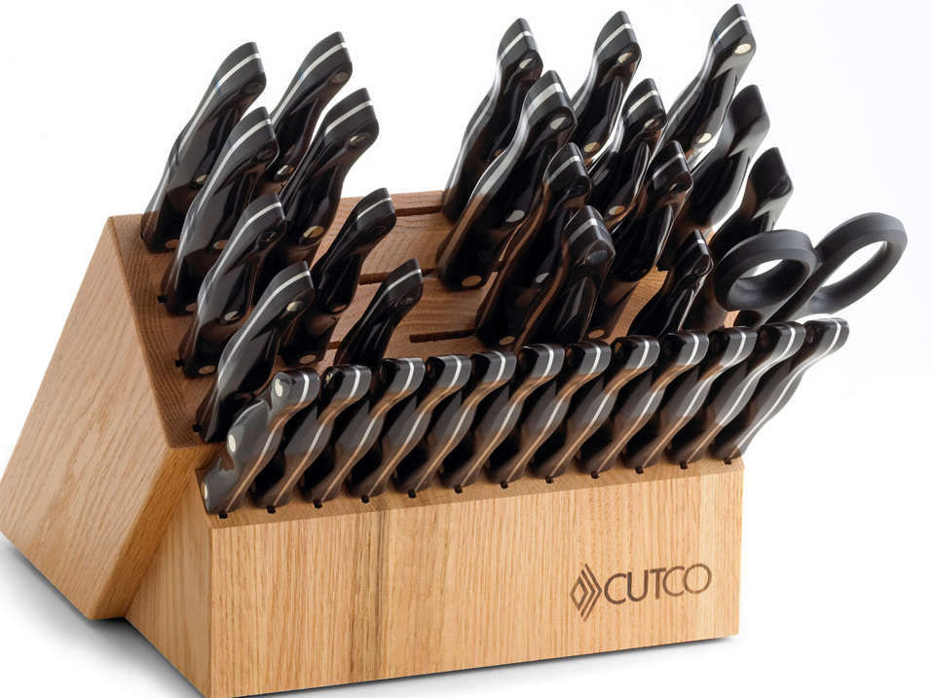
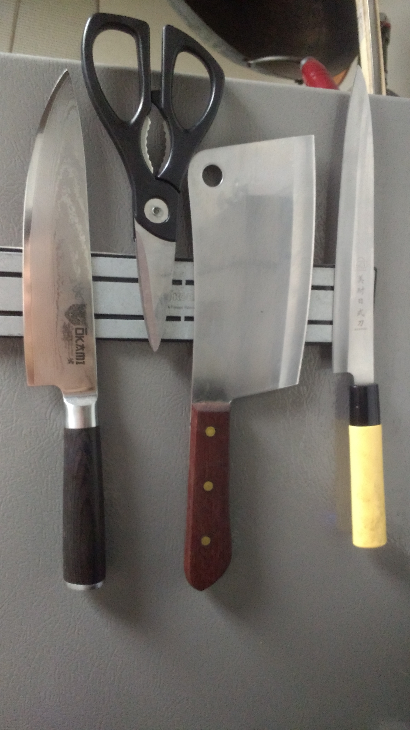
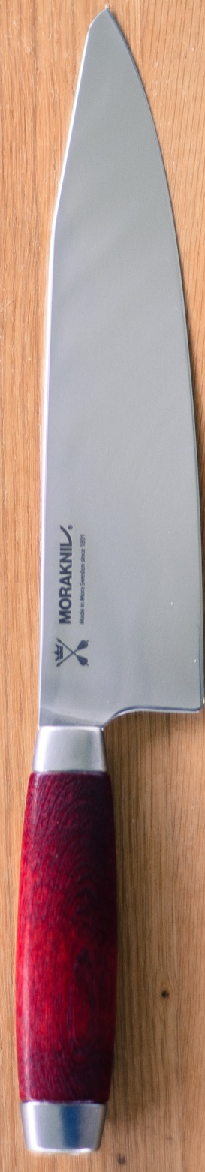
Of course at crazy (enterprise) scales you get this
But that’s to be expected and I’ll say it’s early days yet (Docker started 2013)
I follow the philosophy of the middle path
In this case: use the right tool(s) for the right job
Mostly worthless
My personal suggestion
Dubious

Slide 10
Here’s Our Path to the Compute
Let’s speak in practical terms about our workflow
Day 1
Intro to Docker
Preparing containers
Perhaps Singularity?
Day 2
Docker to Cloud
Docker -> Singularity -> HPC
You figure out the compute resources
All the slides presented will be available to you after the webinar.

Slide 11
Using Ready Made Containers
Pull pre-built containers from DockerHub
Pull a base container and use that (DockerHub)
Go for it!
Let’s sample the natural variation of containers
Start them up and play with them

Slide 12
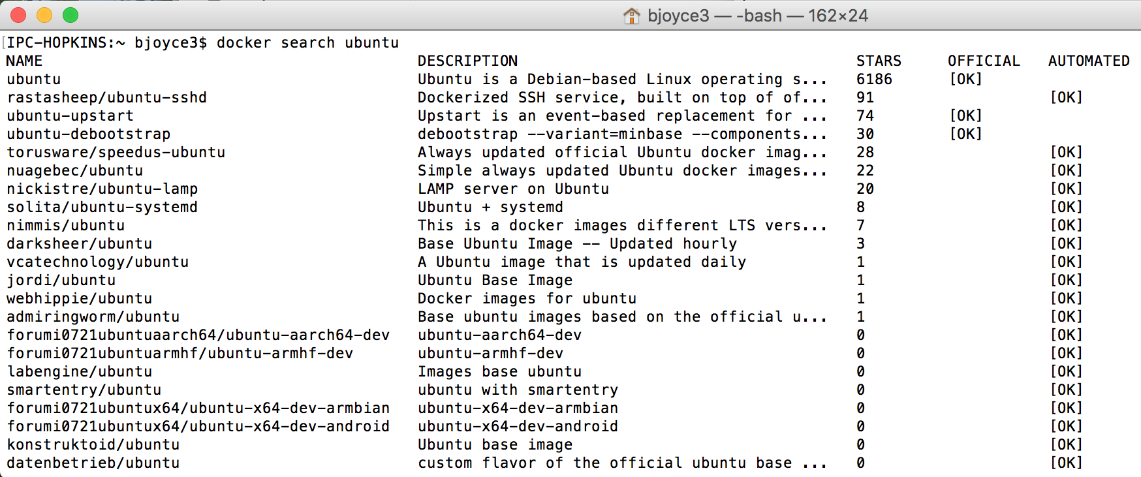
Search DockerHub: Try it out!
Use command line:
`docker search ubuntu`
User DockerHub website: https://hub.docker.com/

Slide 13
Pulling Docker Container
For base OS, try the ‘Official Repository’
https://docs.docker.com/docker-hub/official_repos/
Once you find something you like, pull it to your local

Slide 14
Scaling Up: CyVerse Discovery Environment
Docker Runs Software Here

Slide 15
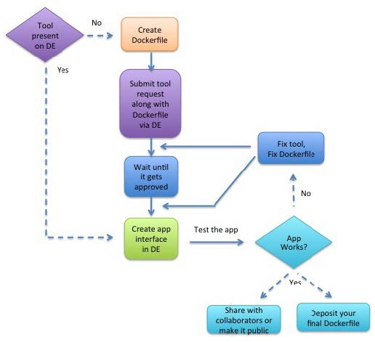
Figure 2. CyVerse App Integration.
From Devisetty 2016
http://dx.doi.org/10.12688/f1000research.8935.3
Pull from DockerHub

Slide 16
Adding a Tool to CyVerse
Test it locally! (Example below; assumes an entrypoint)
Input data is in a scratch directory
Working directory set with `-w` flag
Environmental variables can be passed with `-e` flag
`docker run --rm -v ~/my-scratch-dir:/working-dir
-w /working-dir
your/docker-image
user-input-1 user-input-2`

Slide 17
1
2
3

Slide 18
Here’s Our Path to the Compute
CyVerse Dockerfile best practices
Include all installation steps in the Dockerfile
Example: a Dockerfile should not copy and run a script that
performs Ubuntu APT commands; instead, the APT commands should be in the Dockerfile.
• Write the Dockerfile to fail fast. This means that if anything goes wrong, construction of the image will fail
immediately and the Docker image will not be deployed.
• Encapsulate the tool execution to avoid external dependencies unless by design (e.g., tool provides
integration with external service).
• Derive the tool from an official Docker image (e.g., ubuntu:14.04.3 for the operating system).

Slide 19
Limitations by Platforms
Windows
First of all, if you’re reading this: shame on you. Coding on a Windows box!
Docker is available
Singularity is not (so no HPC)
Mac
All good. This workflow was created on a Mac

Slide 20
Limitations by Your Job Title
Industry
No access to XSEDE/UA HPC/CyVerse without prior discussion
Government
Budgetary terror every 4 years
No UA HPC
Academics
Salary and work/life balance
But no limitations with this workflow (developed by academics)

Slide 21
Homework
Download singularity2docker
Windows folks:
You’ll need a virtual environment
Or access to a non-Windows OS
Windows == Double homework

Slide 24
Run an App in the Discovery Environment

Slide 25
Run an App in the Discovery Environment

Slide 26
Run an App in the Discovery Environment

Slide 27
Run an App in the Discovery Environment

Slide 28
Docker Can Run Software in Atmosphere, too

Slide 30
Docker glossary
Docker image: Ready snapshot of a configured software application.
Docker container: Instance of a Docker image.
Dockerfile: Set of instructions/commands that are used to build the Docker image.
Using Docker in the CyVerse DE
CyVerse has adopted Docker for integrating software apps that run in the CyVerse DE’s Compute Cluster (Condor). The user creates a Dockerfile, which is used to build the Docker image containing the tool that will be used as an app in the DE.

Slide 31
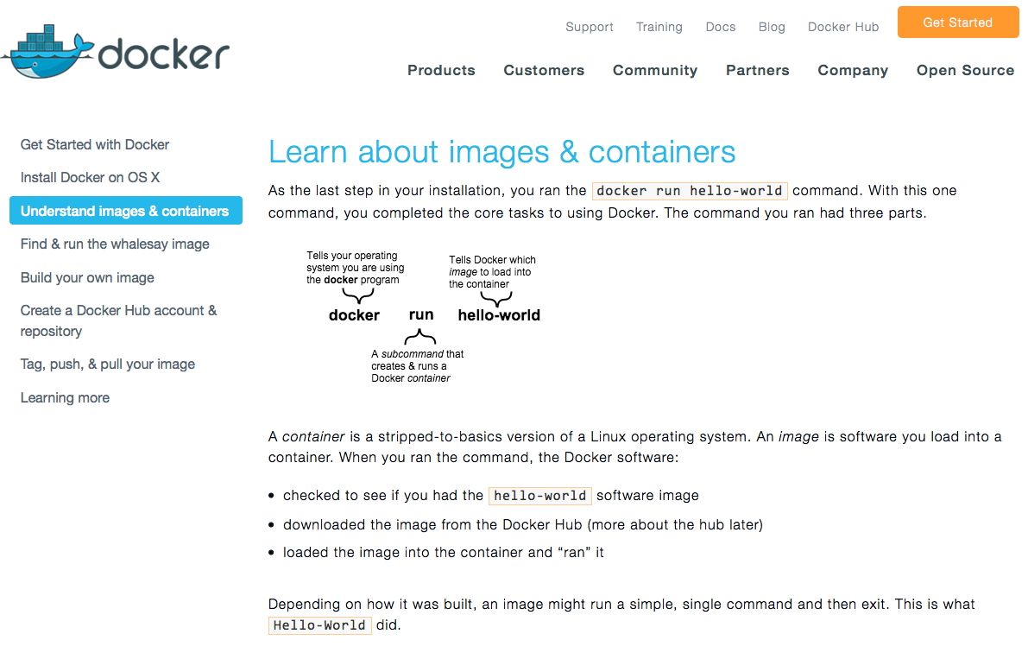
Learn about images & containers
Find & run the whalesay image
Build your own image
Just keep following to the next page of the tutorial – click the orange link at the bottom of each page!

Slide 32
Why do we use Docker for Building Apps in the
Discovery Environment?
Integrating a Dockerized tool into the DE enables users to begin creating apps built on the tool.
Because Dockerized apps use fewer resources, their analyses process more quickly.
Compared to the previous method for tool integration in the DE, this method streamlines the process and makes it more likely that the final DE app will function as the user intended.
It also increases the likelihood that more complicated and difficult to install software can be used in the DE.

Slide 33
Why do you want to use Docker?
You can use your Dockerized apps in the CyVerse Discovery Environment and Atmosphere.
If you are a developer or just write a nice script occasionally, or teach classes, or have a collaborative project, or are publishing a paper that uses a specific workflow:
Share a specific app.
Share a specific version of an app.
Share a whole analysis pipeline.
Anybody can use your software on any computer running Docker.
Anybody can use your software on the Discovery Environment or in Atmosphere.

